Slide 1
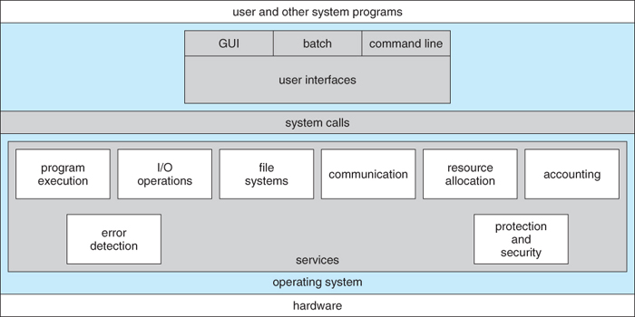
OPERATING SYSTEM SERVICES

Slide 2
Process
Processes
A process can be thought of as a program in execution, A process will need certain resources
such as CPU time, memory, files, and I/O devices
to accomplish its task.
Process is an Active Entity and Program is a Passive Entity.
A process is the unit of work in most systems.
Systems consist of a collection of processes:
Operating-system processes execute system code, and
user processes execute user code.
All these processes may execute concurrently.

Slide 3
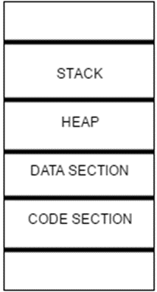
Sections of a Process
Code section
Data Section
Heap Section
Stack Section

Slide 4
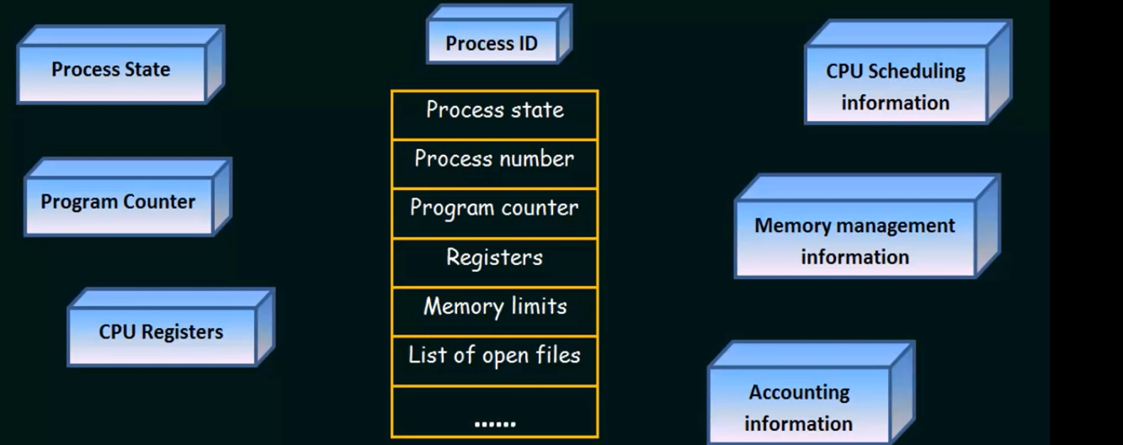
Process Control Block
Process Control Block(data structure used by computer operating systems to store all the information about a process)

Slide 5

Process Control Block
Process Control Block
Process ID (PID)–unique identification number for each process
Process State–New, Ready, Running, Waiting, Terminated
Program Counter (PC)–A pointer to the address of the next instruction to be executed for this process
List of Open files– This information includes the list of files opened for a process.
Memory limits – This field contains the information about memory management system used by operating system.
CPU Registers–Register set where process needs to be stored for execution for running state eg: accumulator, base and general purpose registers.

Slide 6
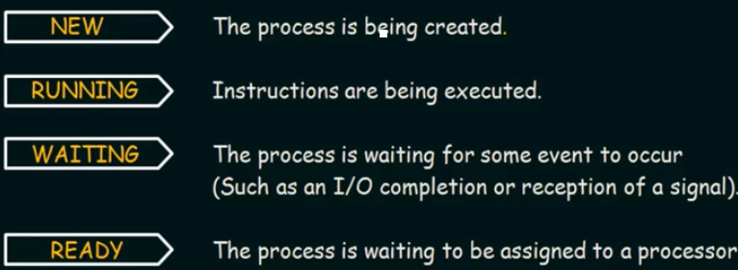
Process States
Process States

Slide 7
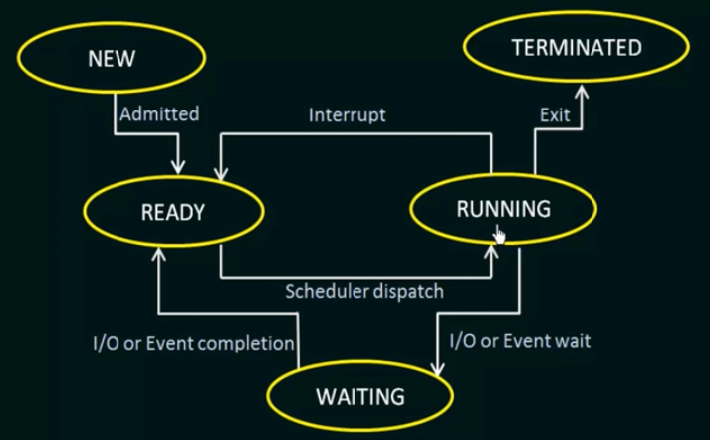
Process States
Process States

Slide 8
Resources
Resources
The OS treats an entity as a resource if it satisfies the below characteristics:
A process must request it from the OS.
A process must suspend its operation until the entity is allocated to it.
The most common source is a file. A process must request a file before it can read it or write it. Further, if the file is unavailable, the process must wait until it becomes available. This abstract description of a resource is crucial to the way various entities(such as files, memory and devices) are managed.

Slide 9
Thread
Thread
A thread is a basic unit of CPU utilization. A thread, sometimes called as light weight process whereas a process is a heavyweight process.
Thread comprises:
A thread ID
A program counter
A register set
A stack.
A process is a program that performs a single thread of execution i.e., a process is a executing program with a single thread of control. For example, when a process is running a word- processor program, a single thread of instructions is being executed.

Slide 10
Thread
Thread
The single thread of control allows the process to perform only one task at one time. For example, the user cannot simultaneously type in characters and run the spell checker within the same process.
Traditionally a process contained only a single thread of control as it ran, many modern operating systems have extended the process concept to allow a process to have multiple threads of execution and thus to perform more than one task at a time.
For example, in a browser, multiple tabs can be different threads

Slide 11
Thread
Thread
The operating system is responsible for the following activities in connection with process and thread management:
The creation and deletion of both user and system processes
The scheduling of processes
The provision of mechanisms for synchronization
Communication
Deadlock handling for processes.

Slide 12
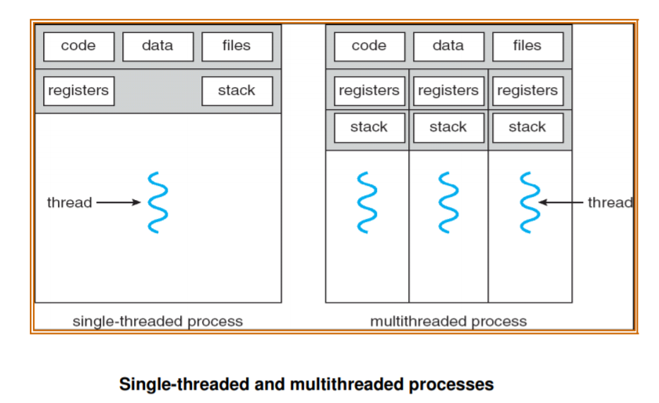
Thread

Slide 13
User Level Thread
User Level Thread
User threads are supported above the kernel and are managed without kernel support i.e., they are implemented by thread library at the user level. These are the threads that application programmers use in their programs.
The library provides support for thread creation, scheduling and management with no support from the kernel.
Because the kernel is unaware of user-level threads, all thread creation and scheduling are done in user space without the need for kernel intervention.
Therefore, user-level threads are generally fast to create and manage. User-thread libraries include POSIX Pthreads, Mach C-threads, and Solaris 2 UI-threads.

Slide 14
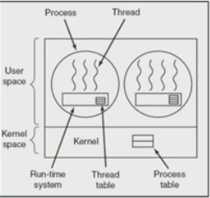
User Level Thread
User Level Thread
Advantage:
Fast
Thread Management happens with thread
library.
Drawback:
Lack of Coordination between Kernel and
Thread
If one thread invokes system call, all threads
has to wait

Slide 15
Kernel Level Thread
Kernel Level Thread
Kernel threads are supported and managed directly by the operating system.
The kernel performs thread creation, scheduling and management in kernel space.
Since thread management is done by the operating system, kernel threads are generally slower to create and manage than are user threads.
Also, in a multiprocessor environment, the kernel can schedule threads on different processors. Most contemporary operating systems—including Windows NT, Windows 2000, Solaris 2,BeOS, and Tru64 UNIX (formerly Digital UNIX)—support kernel threads

Slide 16
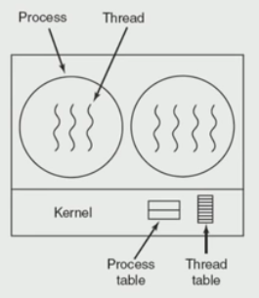
Kernel Level Thread
Kernel Level Thread
Advantage:
Scheduler can decide to give more time to process
having more threads
IF a Thread invokes a system call the remaining
thread will run.
Drawback:
Slow
Overhead to manage thread and process

Slide 17
Multithreading Models
Multithreading Models
Some operating system provide a combined user level thread and Kernel level thread facility. Eg. Solaris.
Three common ways of establishing this relationship are:
Many-to-One Model
One-to-one Model
Many-to-Many Model

Slide 18
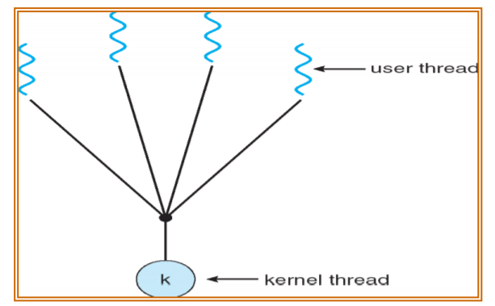
Multithreading Models
Many-to-One Model

Slide 19
Multithreading Models
Many-to-One Model
The many-to-one model maps many user-level threads to one kernel thread.
Thread management is done by the thread library in user space, so it is efficient; but the entire process will block if a thread makes a blocking system call.
Also, because only one thread can access the kernel at a time, multiple threads are unable to run in parallel on multiprocessors. Green threads—a thread library available for Solaris 2—uses this model.

Slide 20
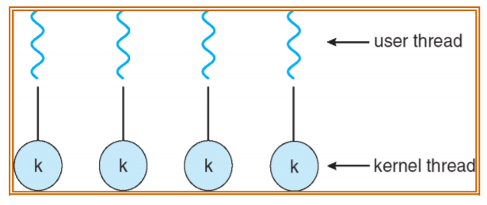
Multithreading Models
One-to-One Model

Slide 21
Multithreading Models
One-to-One Model
The one-to-one model maps each user thread to a kernel thread. It provides more concurrency than the many-to-one model by allowing another thread to run when a thread makes a blocking system call.
It also allows multiple threads to run in parallel on multiprocessors.
The only drawback to this model is that creating a user thread requires creating the corresponding kernel thread.
Linux, along with the family of Windows operating systems—including Windows 95, 98, NT, 2000, and OS/2— implement the one-to-one model.

Slide 22
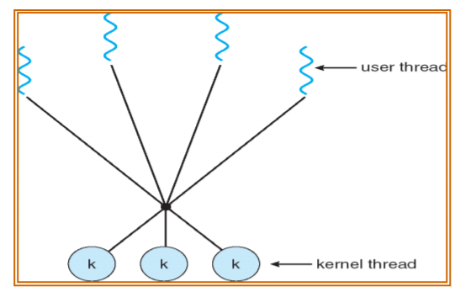
Multithreading Models
Many-to-Many Model

Slide 23
Multithreading Models
Many-to-Many Model
The many-to-many model multiplexes many user-level threads to a smaller or equal number of kernel threads.
The one-to-one model allows for greater concurrency, but the developer has to be careful not to create too many threads within an application.
The many-to-many model suffers from neither of these shortcomings: Developers can create as many user threads as necessary, and the corresponding kernel threads can run in parallel on a multiprocessor. Also, when a thread performs a blocking system call, the kernel can schedule another thread for execution. Solaris 2, IRIX, HP-UX and Tru64 UNIX support this model.

Slide 24
Process Vs Thread
Difference between Process and Thread
Sl.No | Process | Thread
1 | Process means any program is in execution. | Thread means segment of a process.
2 | It takes more time for creation. | It takes less time for creation.
3 | Process is called heavy weight process. | Thread is called light weight process.
4 | Process switching needs interaction with operating system | Thread switching does not need to interact with operating system
5 | In multiple processing environments each process executes the same code but has its own memory and file resources | All threads can share same set of open files, Child processes

Slide 25
Device Management
Device Management
Device management of operating system manages hardware devices via their respective drivers
It deals with the management of the I/O devices such as a keyboard, magnetic tape, disk, printer, microphone, USB ports, scanner, camcorder etc.as well as the supporting units like control channels.
The basics of I/O devices can fall into 3 categories:
Block device: it stores information in fixed-size block. example, disks.
Character device: it delivers or accepts a stream of characters. example printers, keyboards
Network device: For transmitting data packets.

Slide 26
Device Management
Activities of Device Management
It keeps track of all the devices. The program responsible for keeping track of all the devices is known as I/O controller.
It provides a uniform interface to access devices with different physical characteristics.
It allocates the devices in an efficient manner.
It deallocates the devices after usage.
It decides which process gets the device and how much time it should be used.
It optimizes the performance of each individual device.

Slide 27
Device Management
Approaches
Approaches
Direct I/O
Memory Mapped I/O
Direct Memory Access

Slide 28
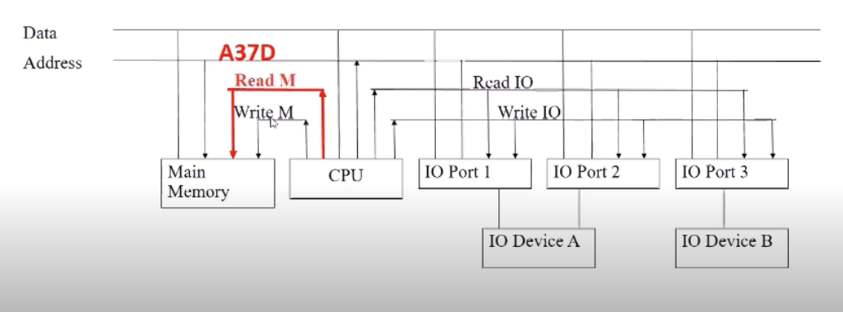
Device Management
Approaches
Direct I/O
CPU software explicitly transfer data to and from the controller’s data registers.
Separate Control signal for Memory and I/O Devices
Common Address and Data Bus for I/O Devices and Memory

Slide 29
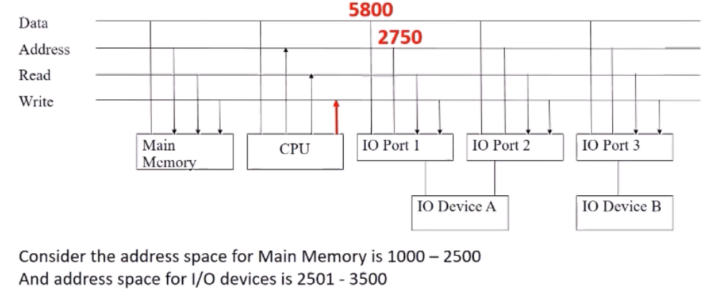
Device Management
Approaches
MEMORY MAPPED I/O
Device addressing simplifies the interface (device seen as a range of memory locations)
Common Control signal for Memory and I/O Devices
Common Address and Data Bus for I/O Devices and Memory

Slide 30
I/O System Organization
An application process uses a device by issuing commands and exchanging data with the device management (device driver).
Device driver responsibilities:
Implement communication APIs that abstract the functionality of the device
Provide device dependent operations to implement functions defined by the API
API should be similar across different device drivers, reducing the amount of info an application programmer needs to know to use the device

Slide 31
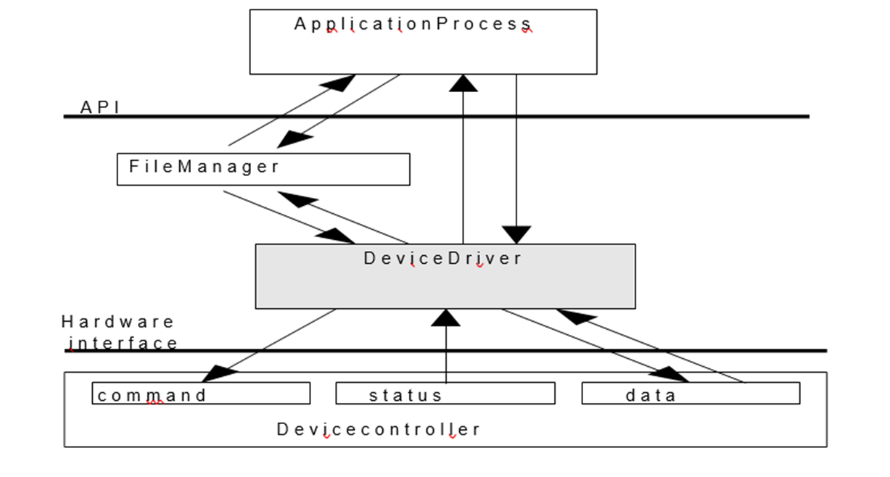
I/O System Organization

Slide 32
I/O System Organization
Since each device controller is specific to a particular device, the device driver implementation will be device specific, to
Provide correct commands to the controller
Interpret the controller status register (CSR) correctly
Transfer data to and from device controller data registers as required for correct device operation

Slide 33
I/O with Polling
Each I/O operation requires that the software and hardware coordinate their operations to accomplish desired effect
In direct I/O polling this coordination is done in the device driver;
While managing the I/O, the device manager will poll the busy/done flags to detect the operation’s completion; thus, the CPU starts the device, then polls the CSR to determine when the operation has completed
With this approach is difficult to achieve high CPU utilization, since the CPU must constantly check the controller status

Slide 34
I/O with polling-read
Application process requests a read operation
The device driver queries the CSR to determine whether the device is idle; if device is busy, the driver waits for it to become idle
The driver stores an input command into the controller’s command register, thus starting the device
The driver repeatedly reads the content of CSR to detect the completion of the read operation
The driver copies the content of the controller's data register(s) into the main memory user’s process’s space.

Slide 35
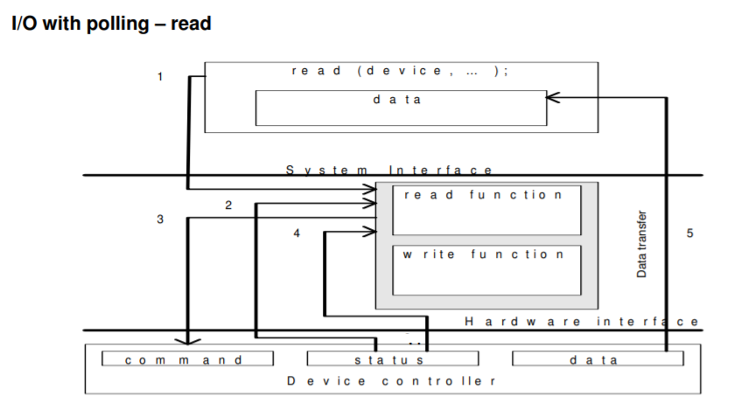

Slide 36
I/O with polling-write
The application process requests a write operation
The device driver queries the CSR to determine if the device is idle; if busy, it will wait to become idle
The device driver copies data from user space memory to the controller’s data register(s)
The driver stores an output command into the command register, thus starting the device
The driver repeatedly reads the CSR to determine when the device completed its operation.

Slide 37
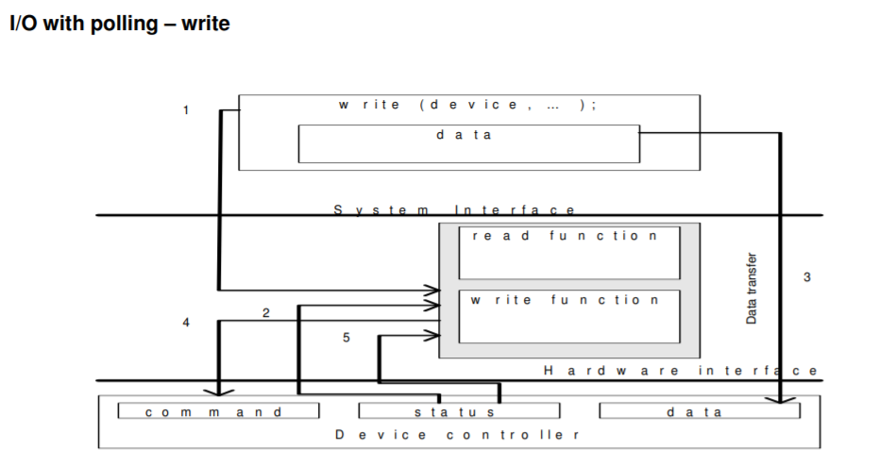

Slide 38
Interrupt driven I/O
In a multiprogramming system the wasted CPU time (in polled I/O) could be used by another process; because the CPU is used by other processes in addition to the one waiting for the I/O operation completion.
This may be remedied by use of interrupts
The reason for incorporating the interrupts into a computer hardware is to eliminate the need for a device driver to constantly poll the CSR
Instead polling, the device controller “automatically” notifies the device driver when the operation has completed.

Slide 39
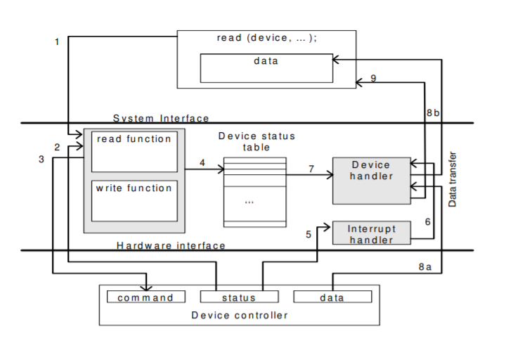

Slide 40
Interrupt driven I/O
Interrupt driven I/O
The application process requests a read operation
The device driver queries the CSR to find out if the device is idle; if busy, then it waits until the device becomes idle
The driver stores an input command into the controller’s command register, thus starting the device
When this part of the device driver completes its work, it saves information regarding the operation it began in the device status table; this table contains an entry for each device in system; the information written into this table contains the return address of the original call and any special parameters for the I/O operation; the CPU, after doing this, can be used by other program, so the device manager invokes the scheduler part of the process manager. It then terminates

Slide 41
Interrupt driven I/O
Interrupt driven I/O
The device completes the operation and interrupts the CPU, therefore causing an interrupt handler to run
The interrupt handler determines which device caused the interrupt; it then branches to the device handler for that device
The device driver retrieves the pending I/O status information from the device status table
(a,b) The device driver copies the content of the controller’s data register(s) into the user process’s space
The device handler returns the control to the application process (knowing the return address from the device status table). Same sequence (or similar) of operations will be accomplished for an output operation.

Slide 42
Buffering
Buffering
Buffering is a technique by which a device manager keeps the slower I/O devices busy when a process is not requiring I/O operations.
A buffer is a memory area that stores data being transferred between two devices or between a device and an application.
Input buffering is the process of reading the data into the primary memory before the process requests it.
Output buffering is the process of saving the data in the memory and then writing it to the device while the process continues its execution.

Slide 43
Buffering
Hardware level buffering
Consider a simple character device controller that reads a single byte form a modem for each input operation.
Normal operation: read occurs, the driver passes a read command to the controller; the
controller instructs the device to put the next character into one-byte data controller’s
register; the process calling for byte waits for the operation to complete and then retrieves
the character from the data register
Add a hardware buffer to the controller to decrease the amount of time the process has to wait
Buffered operation: the next character to be read by the process has already been
placed into the data register, even the process has not yet called for the read operation

Slide 44
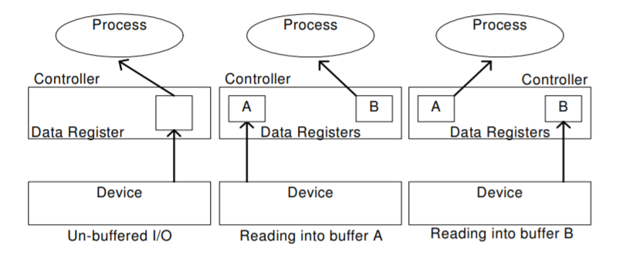
Buffering
Hardware level buffering

Slide 45
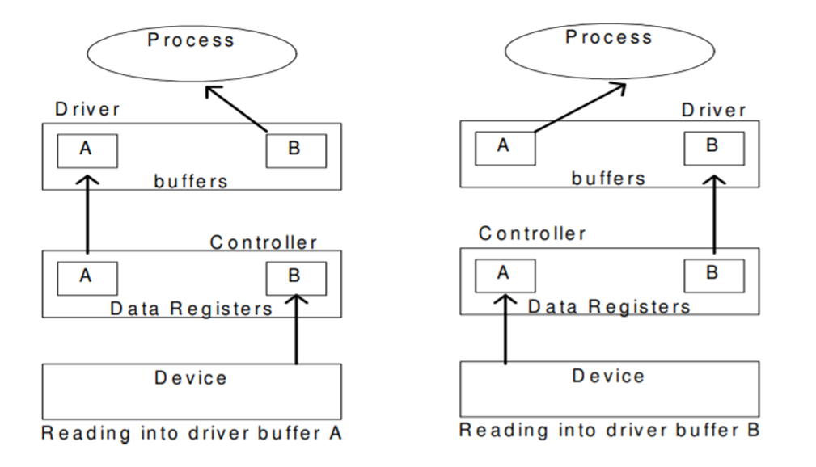
Buffering
Driver level buffering
This is generally called double buffering. One buffer is for the driver to store the data while waiting for the higher layers to read it. The other buffer is to store data from the lower level module. This technique can be used for the block-oriented devices (buffers must be large enough to accommodate a block of data).

Slide 46
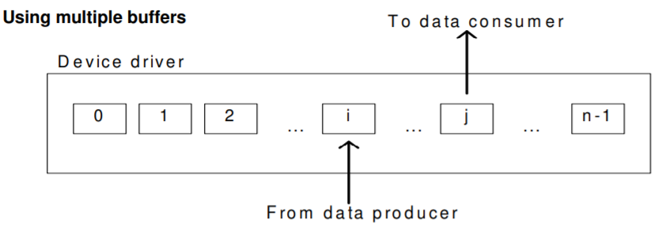
Buffering
Driver level buffering
The number of buffers is extended from two to n. The data producer is writing into buffer i while the data consumer is reading from buffer j.
In this configuration buffers j+1 to n-1 and 0 to i-1 are full. This is known as circular buffering
technique.

Slide 47
Device Driver
Device driver
It is a software program that controls a particular type of device attached to the computer. It provides an interface to the hardware devices without the requirement to know the precise information about the hardware.
A device driver communicates with the device through a bus or communication sub system.
Responsibilities
Initialize devices
Interpreting the commands from the operating system
Manage data transfers
Accept and process interrupts
Maintain the integrity of driver and kernel data structures

Slide 48
Device Driver
Two ways of dealing with the device drivers
Old way: Driver is part of the operating system, to add a new device driver, the whole OS must have been complied
Modern way: Drivers installation is allowed without re-compilation of the OS by using reconfigurable device drivers; the OS dynamically binds the OS code to the driver functions.
A reconfigurable device driver has to have a fixed, standardized API
The Kernel has to provide an interface to the device driver to allocate/de-allocate space for buffers, manipulate tables in the kernel etc.

Slide 49
Device Driver
Reconfigurable device drivers

Slide 50
The driver - kernel interface
The OS uses an indirect reference table to access the different driver entry points, based on the device identifier and function name. The indirect reference table is filled with appropriate values whenever the device driver loads
When a process performs a system call, the kernel passes the call onto the device driver via the indirect reference table.

Slide 51
Direct Memory Access
DIRECT MEMORY ACCESS
Involves designing of hardware to avoid the CPU perform the transfer of information between the device.
Normally Data transfer from I/O to Memory happens in two cycle.
I/O to CPU
CPU to Memory
Using DMA data can be transferred directly from I/O to Memory

Slide 52
Direct Memory Access
Direct Memory Access
It consists of Four Blocks
CPU
DMAC(Direct Memory Access Controller)
Disk controller
Memory
Steps in Direct Memory Access
CPU will set the registers of DMAC(ie) CPU programs the DMAC by setting its Registers
CPU instruct the disk controller to read the data from the drive and store it in buffer.
DMAC request disk controller to transfer data to memory
Disk Controller will transfer the data to memory
Disk Controller will send the acknowledgement to the DMA Controller after transferring the data.
After getting the acknowledgement the DMA Controller will decrement the count.
Once the Byte count is zero, it tells to CPU the Data transfer is over.

Slide 53
Direct Memory Access
DIRECT MEMORY ACCESS

